Slide 1
INTRODUCTION
SATELLITE IMAGE PROCESSING PROJECT
GROUP MEMBERS :
24M0315 Rita Mahato
24M0325 Mohd Akbar Mohd Haider Zaidi
24M0329 Salah Ud Din

Slide 2
PROBLEM STATEMENT
6. Display a gray scale image, its pseudo-color display for a user-specified gray scale range, and its
negative. Display the histogram to facilitate thresholds and gray level range. Threshold the gray level
image using three user-specified thresholds and display the result.

Slide 3
APPROACH
We are taking an image file as input and converting it into greyscale.
Then displaying the same image in pseudo-color
Then the negative of the image is displayed.
Then the histogram is plotted.
Finally according to the three threshold values given by the user thresholding is done on the image and displayed.

Slide 4
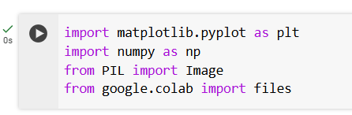
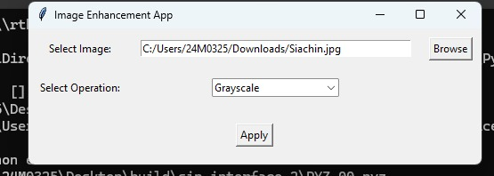
implementation
NumPy is a fundamental package for numerical computation in Python. It provides support for large, multi-dimensional arrays and matrices, along with a collection of mathematical functions to operate on these arrays.
Matplotlib is a powerful and flexible plotting library for Python. It is used for creating static, animated, and interactive visualizations in Python.
Taking input image from the user and reading the file
Converting the image into greyscale and storing it as numpy array in a variable img_array.

Slide 5
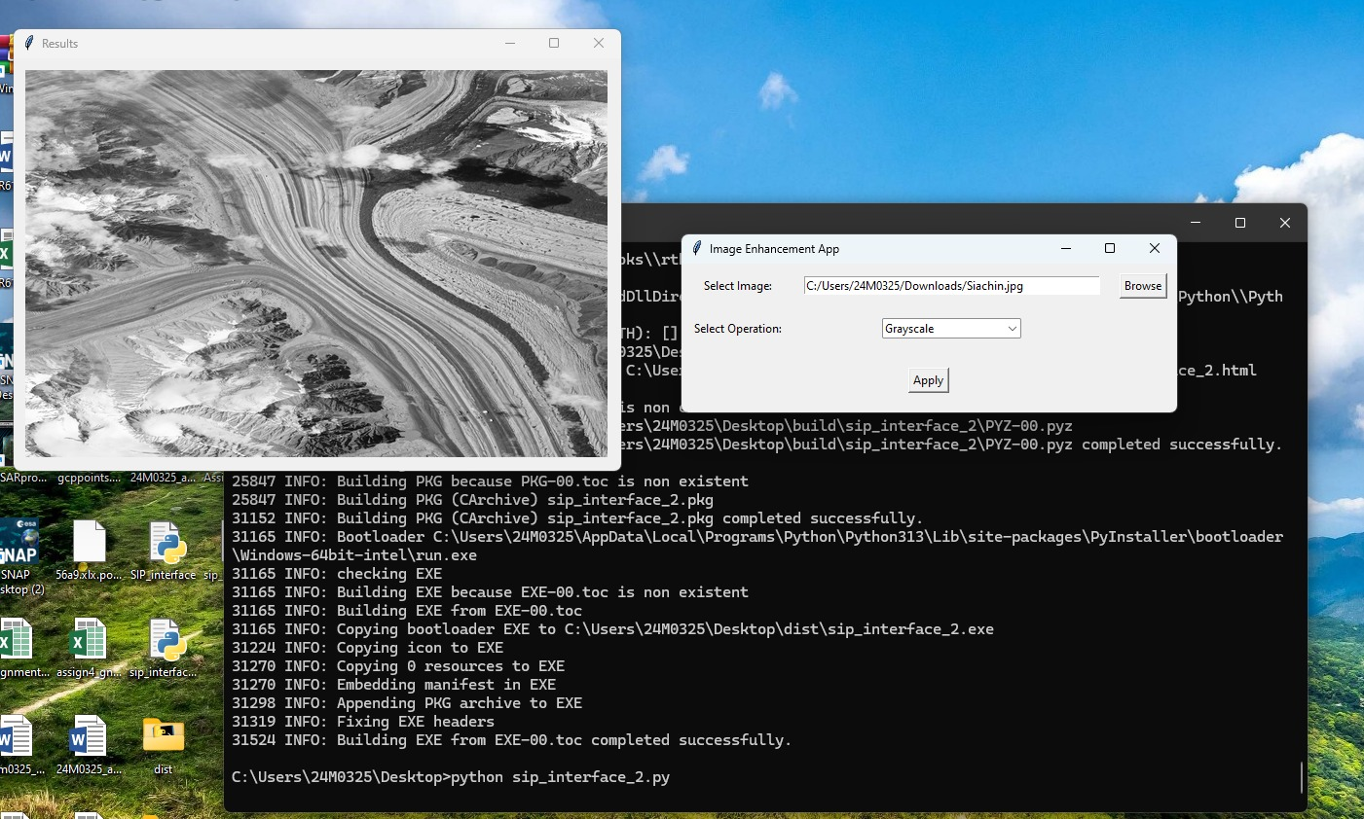
implementation
Plotting the greyscale image.

Slide 6
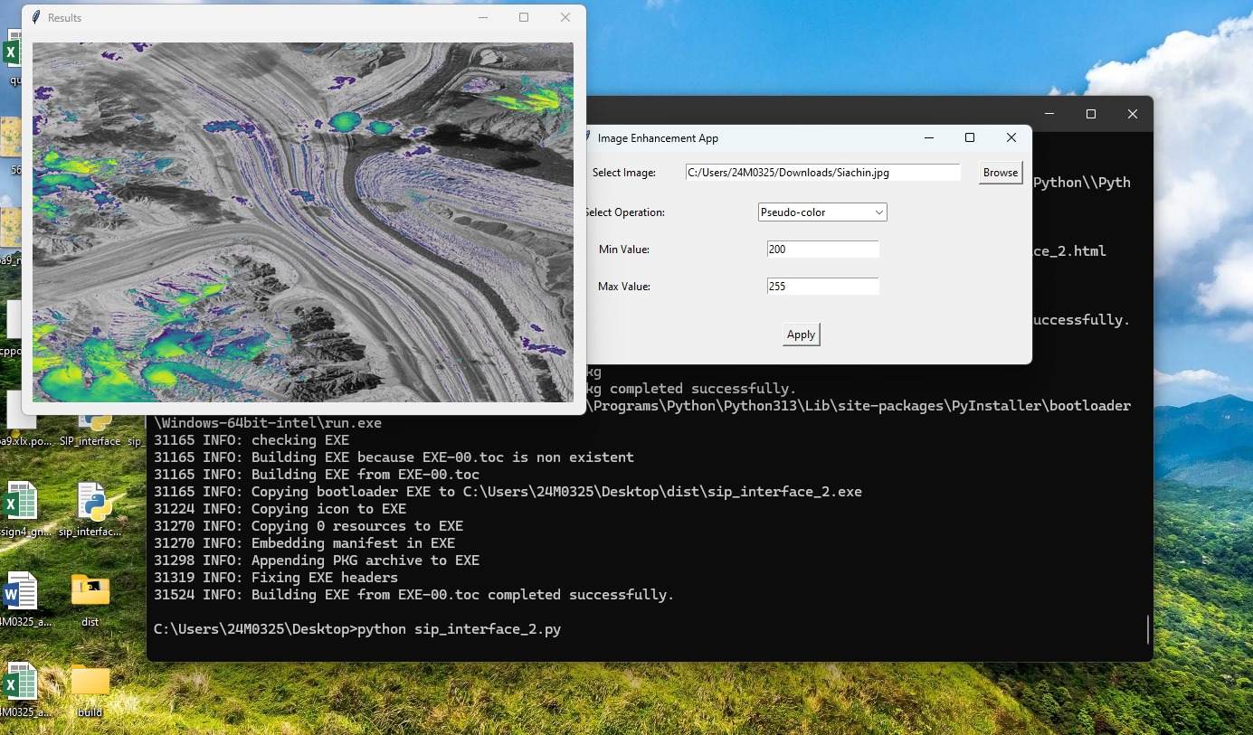
implementation
A function is defined called “pseudo_color” to convert the image into pseudo-color according to the user input range.
Then the result image is plotted with title.

Slide 7
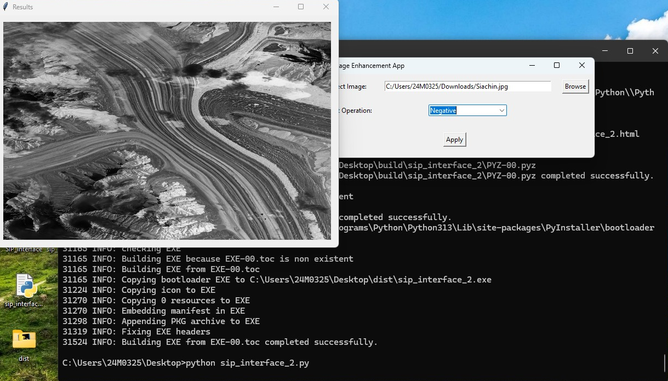
implementation
To get the negative of the image we are subtracting all the values in img_array from 255.
Then the resultant image is plotted with title.

Slide 8
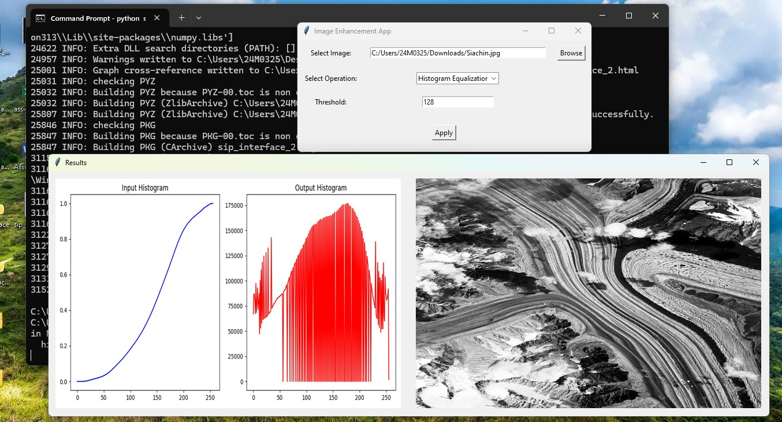
implementation
Histogram of the image is plotted using matplotlib.

Slide 9
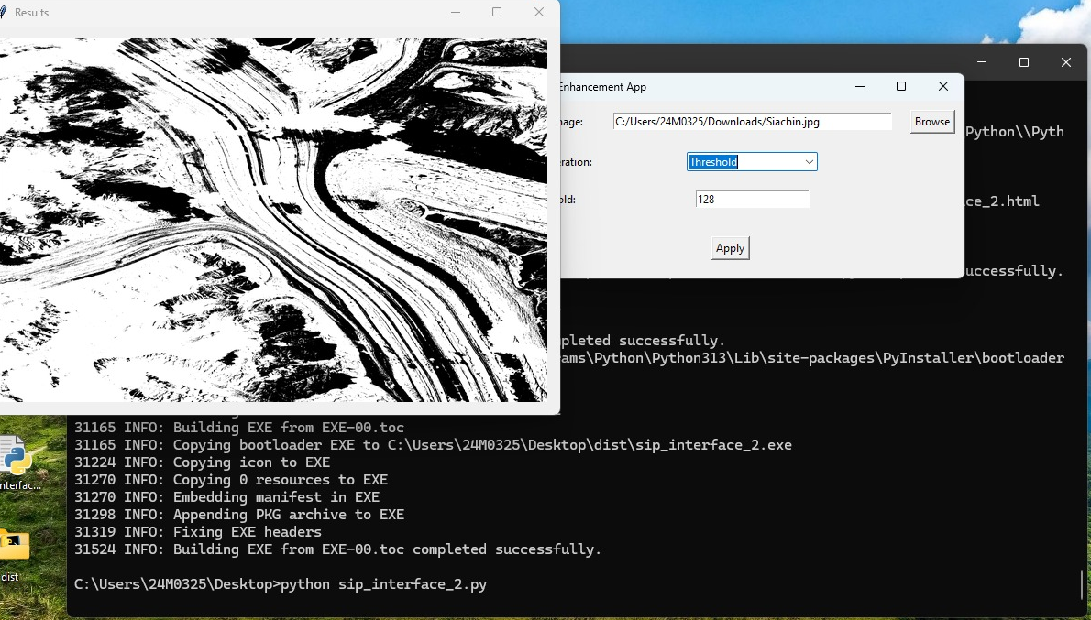
implementation
Another function called “apply_threshold” is defined and three input values are taken for thresholding.
Thresholding is done for all the three images by calling the above function and the results are plotted using matplotlib.

Slide 10
Project Link :
https://colab.research.google.com/drive/1JyBnkqhrx0YgX7nYsXzSEMatmMBNE374?usp=sharing
Github Link :
https://github.com/akbarzaidi/SIP_Project.git
THANK
YOU

